Slide 1

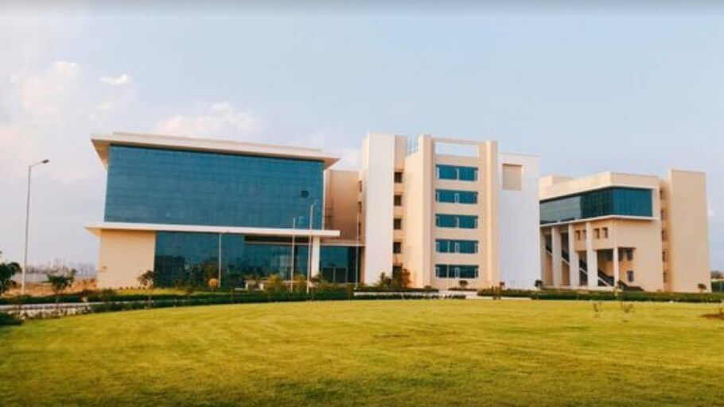
IIIT LUCKNOW SUSTAIN-FLUENCE : NAVIGATING THE LANDSCAPE OF SUSTAINABLE MARKETING THROUGH SOCIAL MEDIA INFLUENCERS
PRESENTER’S: SHIWANGI SINGH
DYOVAN MADHAV
HRISHABH SUKHLA
SHEFALI SRIVASTAVA

Slide 3
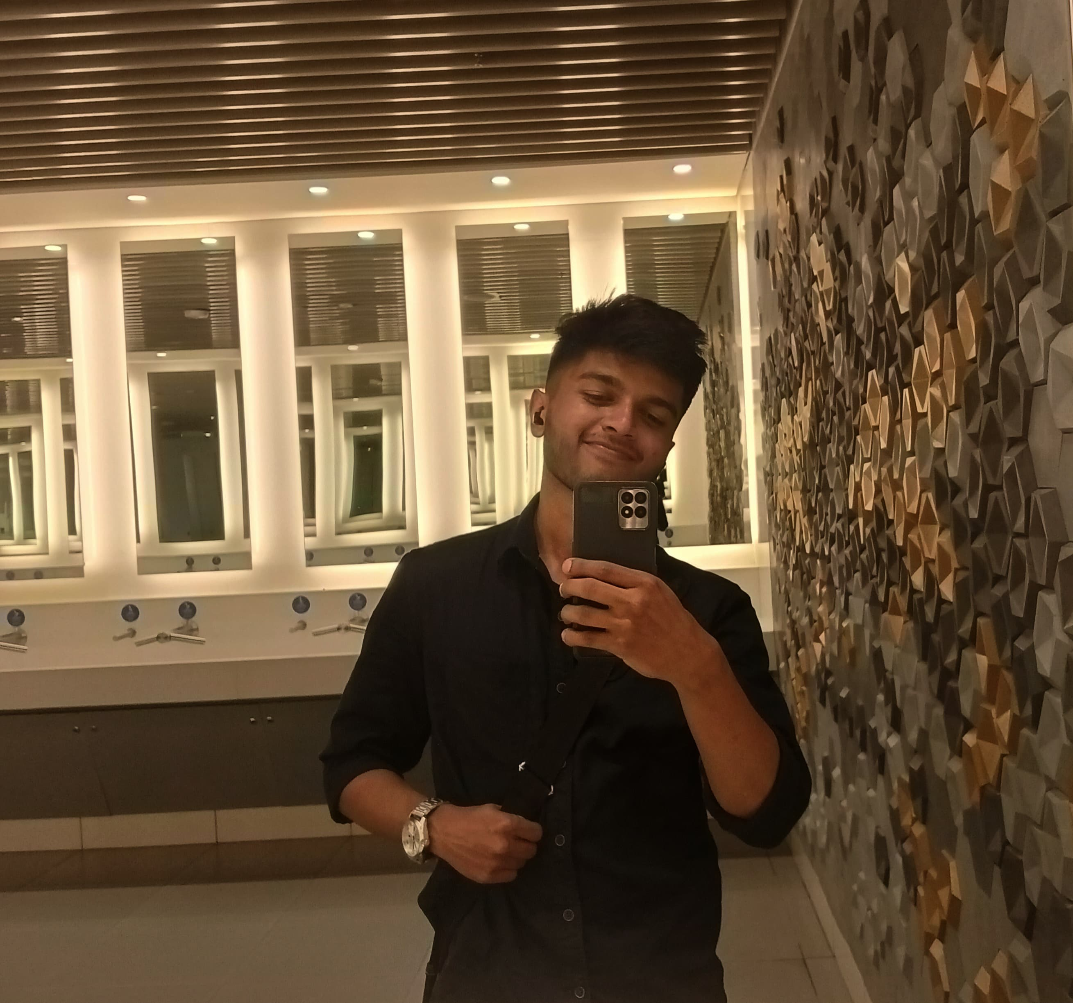
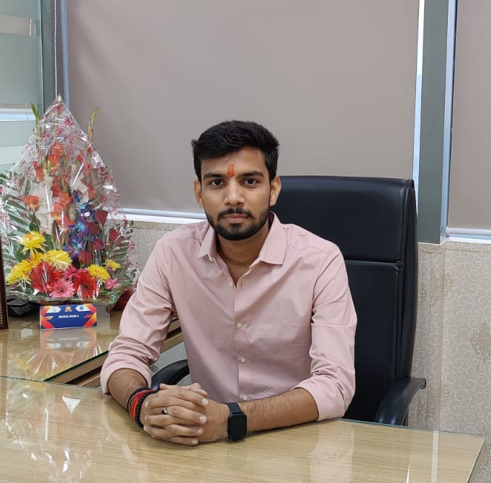

Shiwangi Singh
IIIT LUCKNOW
Shiwangi Singh
IIIT LUCKNOW
Shiwangi Singh
IIIT LUCKNOW
Shiwangi Singh
IIIT LUCKNOW

Slide 4

Table Of Content
Introduction
Problem Statement
Objective
Findings
Analysis (SWOT)
Conclusion
Further Questions

Slide 5

INTRODUCTION
In today's digitally connected era, social media has become a powerful tool, not just for communication, but also as a dynamic force in marketing. The vast reach and influential capabilities of social media platforms provide businesses with a unique opportunity to enhance their online presence and positively contribute to the planet. This study explores how influencers, in the age of online dominance, leverage their reach to champion sustainable practices, products, and lifestyles. It aims to analyze the impact of social media on shaping sustainability discourse, examining how influencers contribute to the dissemination of eco-friendly initiatives and advocate for environmentally conscious choices. Additionally, the study delves into the role of social media platforms in fostering a sense of environmental responsibility among users.

Slide 6

PROBLEM STATETMENT
How does the increasing influence of social media and influencers in the digital era impact the promotion and adoption of sustainable practices, products, and lifestyles? This study aims to investigate the role of influencers in shaping sustainability discourse, analyzing their contributions to the dissemination of eco-friendly initiatives, and exploring the influence of social media platforms in fostering environmental responsibility among users.

Slide 7

OBJECTIVE
1. Analyze how influencers leverage their reach to champion sustainable practices, products, and lifestyles.
1
2. Evaluate the impact of social media on shaping the discourse around sustainability.
2
3. Investigate the role of influencers in disseminating eco-friendly initiatives and advocating for environmentally conscious choices.
3
4. Explore the contribution of social media platforms in fostering a sense of environmental responsibility among users.
4

Slide 8
FINDING
1
2
3
Impact on Sustainability Discourse
Dissemination of Eco-Friendly Initiatives
Fostering Environmental Responsibility

Slide 9
Impact on Sustainability Discourse
Influencers shape sustainability conversations online.
Diverse approaches broaden the reach of eco-friendly messages.
Collective impact reinforces the importance of sustainability.

Slide 10
Dissemination of Eco-Friendly Initiatives
Influencers spread information about eco-friendly initiatives.
Creative content and collaborations amplify visibility.
Bridge gap between awareness and action.

Slide 11
Fostering Environmental Responsibility
Build a community of environmentally conscious followers.
Social media platforms catalyze environmental responsibility.
Inspire users to adopt sustainable behaviors for positive change.

Slide 12
INFLUENCER

Slide 13
Pankti Pandey (zerowasteadda)
Advocates zero-waste living.
Raises awareness about waste reduction practices.
Engages followers through challenges and discussions.

Slide 14
Nayana Premnath
Promotes eco-friendly products and ethical consumerism.
Showcases sustainability in style choices.
Utilizes a visual and relatable approach.

Slide 15
Akash Ranison
Champions environmental causes on social media.
Participates in and organizes campaigns for climate change.
Connects with followers through storytelling and personal experiences.

Slide 16
ANALYSIS

Slide 17
Strengths
Relevance to current societal concerns.
Inclusion of diverse influencers.
Offers practical insights for sustainability promotion.

Slide 18
Weaknesses
Subjectivity in interpreting influencers' impact.
01
Limited generalizability due to specific focus.
02
Vulnerable to the dynamic nature of social media trends.
03

Slide 19
Opportunities
Informing policies for influencers and businesses.
Collaboration opportunities for sustainable initiatives.
Educational outreach based on study insights.

Slide 20
Threats
Risk of influencers being perceived as inauthentic.
Impact of changing algorithms on social media platforms.
Competition from conflicting narratives in sustainability messaging.

Slide 21
CONCLUSION
This case study illuminates the powerful nexus between social media influencers and sustainable marketing. Through the lens of influencers like Pankti Pandey (zerowasteadda), Nayana Premnath, and Akash Ranison, we witness the transformative impact on sustainability discourse. Their ability to engage diverse audiences, promote eco-friendly practices, and foster environmental responsibility underscores a compelling opportunity for businesses in the realm of sustainable marketing. As we navigate the dynamic landscape of digital communication, this study signals the potential for authentic influencer collaborations to not only amplify brand visibility but also champion positive environmental change. It prompts us to recognize influencers as catalysts for shaping not just consumer choices, but a collective commitment to a more sustainable future.

Slide 22

THANK YOU

